Slide 1
IEEE Std 754: IEEE Standard for Floating-Point Arithmetic
Edward

Slide 2
What will not cover
Detail corner case for each operation
Leave it for verification plans
Decimal floating point
Extended and extendable precisions

Slide 3
Introduction
Floating Point Formats
(-1)^{S}‧2^{e-bias}‧1.b₁b₂…b_{p-1}
Denormalized Number (Subnormal in 2008 Std)
Single precision: e = 0, f ≠ 0, value = (-1)^{S}‧2⁻¹²⁶‧(0.f)
Double precision: e = 0, f ≠ 0, value = (-1)^{S}‧2⁻¹⁰²²．(0.f)

Slide 4
Parameter | binary16 | binary32 (Single precision) | binary64 (Double precision) | binary128
Bits of precision, p | 10+1 | 23+1 | 52+1 | 112+1
Representation of b0 integer bit | Hidden 1 | Hidden 1 | Hidden 1 | Hidden 1
Bits for Significand field (f) | 10 | 23 | 52 | 112
Significand range | [1 , 2 - 2⁻¹⁰] | [1 , 2 - 2⁻²³] | [1 , 2 - 2⁻⁵²] | [1 , 2 - 2⁻¹¹²]
Bits for Exponent field (e) | 5 | 8 | 11 | 15
Exponent bias | 15 | 127 | 1023 | 16383
Max exponent: emax | 15 (e = 30) | 127 (e = 254) | 1023 (e = 2046) | 16383 (e = 32766)
Minimum exponent: emin | -14 (e = 1) | -126 (e = 1) | -1022 (e = 1) | -16382 (e = 1)
Reserved Biased Exponent (e) | 0, 31 | 0, 255 | 0, 2047 | 0, 32767

Slide 5
Format
Zero
+0 : S = 0, e = 0, and f = 0
-0 : S = 1, e = 0, and f = 0
Infinities
+∞
Single precision: S = 0, e = 255 (0xFF), and f = 0
Double precision: S = 0, e = 2047 (0x7FF), and f = 0
-∞
Single precision: S = 1, e = 255 (0xFF), and f = 0
Double precision: S = 1, e = 2047 (0x7FF), and f = 0

Slide 6
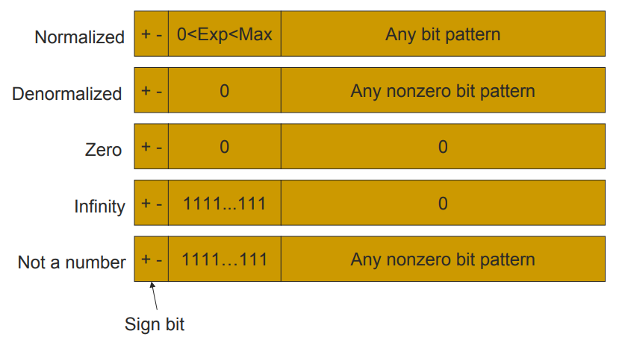

Slide 7
Format
NaNs
Single precision: e = 255 (0xFF), and f ≠ 0, regardless of S
Double precision: e = 2047 (0x7FF), and f ≠ 0, regardless of S
Single precision
Signaling NaNs: Bit[22] = 0, others: any, but ≠ 0
Quiet NaNs: Bit[22] = 1 , others: any, but ≠ 0
Double precision
Signaling NaNs: Bit[51] = 0 , others: any, but ≠ 0
Quiet NaNs: Bit[51] = 1 , others: any, but ≠ 0
Floating-point Format | New QNaN value
Single-precision | 0xFFFFFFFF
Double-precision | 0xFFFFFFFF FFFFFFFF

Slide 8
NaNs
Signaling NaNs
uninitialized variables
arithmetic-like enhancements
Quiet NaNs
left to the implementer’s discretion
afford retrospective diagnostic information inherited from invalid or unavailable data and results
Notes:
Under default exception handling, any operation signaling an invalid operation exception and for which a
floating-point result is to be delivered shall deliver a quiet NaN.
Signaling NaNs shall be reserved operands that, under default exception handling, signal the invalid
operation exception (see 7.2) for every general-computational and signaling-computational operation except
for the conversions described in 5.12. For non-default treatment, see 8.

Slide 9
Rounding
Takes a number regarded as infinitely precise and modifies it to fit in the destination’s format
signaling the inexact exception, underflow, or overflow when appropriate
Rounding-direction attributes to nearest
roundTiesToEven (default)
roundTiesToAway
Directed rounding attributes
roundTowardPositive
roundTowardNegative
roundTowardZero

Slide 10
Invalid Operation Exception
signaled if and only if there is no usefully definable result
signaling NaN, (±∞) + (∓∞), 0*∞, 0/0, ∞/∞
fusedMultiplyAdd: fusedMultiplyAdd(0, ∞, c) or fusedMultiplyAdd(∞, 0, c)
√-N, translate NAN or ∞ to Integer
…
Notes:
a) any general-computational or signaling-computational operation on a signaling NaN (see 6.2), except for some conversions (see 5.12)
b) multiplication: multiplication(0, ∞) or multiplication(∞, 0)
c) fusedMultiplyAdd: fusedMultiplyAdd(0, ∞, c) or fusedMultiplyAdd(∞, 0, c) unless c is a quiet NaN; if c is a quiet NaN then it is implementation defined whether the invalid operation exception is signaled
d) addition or subtraction or fusedMultiplyAdd: magnitude subtraction of infinities, such as: addition(+∞, −∞)
e) division: division(0, 0) or division(∞, ∞)
f) remainder: remainder(x, y), when y is zero or x is infinite and neither is NaN
g) squareRoot if the operand is less than zero
h) quantize when the result does not fit in the destination format or when one operand is finite and the other is infinite
For operations producing no result in floating-point format, the operations that signal the invalid operation exception are:
i) conversion of a floating-point number to an integer format, when the source is NaN, infinity, or a value that would convert to an integer outside the range of the result format under the applicable
rounding attribute
j) comparison by way of unordered-signaling predicates listed in Table 5.2, when the operands are unordered
k) logB(NaN), logB(∞), or logB(0) when logBFormat is an integer format (see 5.3.3).

Slide 11
Inexact exception
the rounded result differs from what would have been computed were both exponent range and precision unbounded

Slide 12
Overflow exception
Rounded floating-point result > destination format’s largest finite number
Default result shall be determined by the rounding-direction attribute
roundTiesToEven and roundTiesToAway => ±∞
roundTowardZero => largest finite number
roundTowardNegative
positive overflows => largest finite number
negative overflows => −∞
roundTowardPositive
negative overflows => most negative finite number, and
positive overflows => +∞.

Slide 13
Underflow exception
Tininess
after rounding — when a non-zero unbounded exponent range result lies strictly between ±b^{emin}
before rounding — when a non-zero unbounded exponent range and precision result lies strictly between ±b^{emin}
default exception handling
deliver a rounded result
Notes:
Bug 17107 - [FPU] Underflow is unexpected raised when the result is rounding from subnoraml number to the minimum normal number (edit)
In addition, under default exception handling for underflow, if the rounded result is inexact — that is, it
differs from what would have been computed were both exponent range and precision unbounded — the
underflow flag shall be raised and the inexact (see 7.6) exception shall be signaled. If the rounded result is
exact, no flag is raised and no inexact exception is signaled. This is the only case in this standard of an
exception signal receiving default handling that does not raise the corresponding flag. Such an underflow
signal has no observable effect under default handling.

Slide 14
Divide by Zero exception
Division: divisor is zero, dividend is a finite non-zero number
logB(0)

Slide 15
Operations
Arithmetic
An implementation shall provide the add, subtract, multiply, divide, and remainder operations
Square root
Floating point format conversions
Conversion between floating-point and integer formats

Slide 16
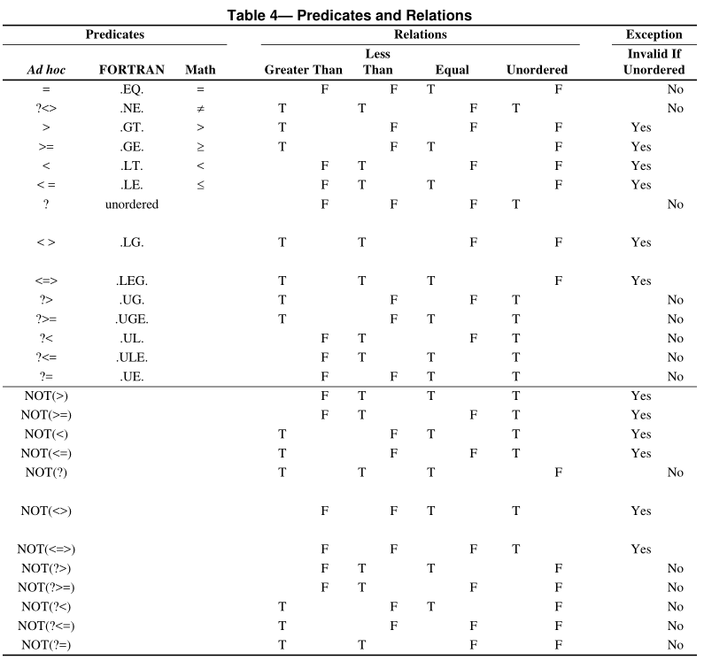
Comparsion

